Slide 1


Foundations of Entrepreneurship
Manoj Kumar Mondal
Rejendra Mishra School of Engineering Entrepreneurship, IIT Kharagpur
Topic: Introduction
Lecture #: 01 (06.01.2021)

Slide 2
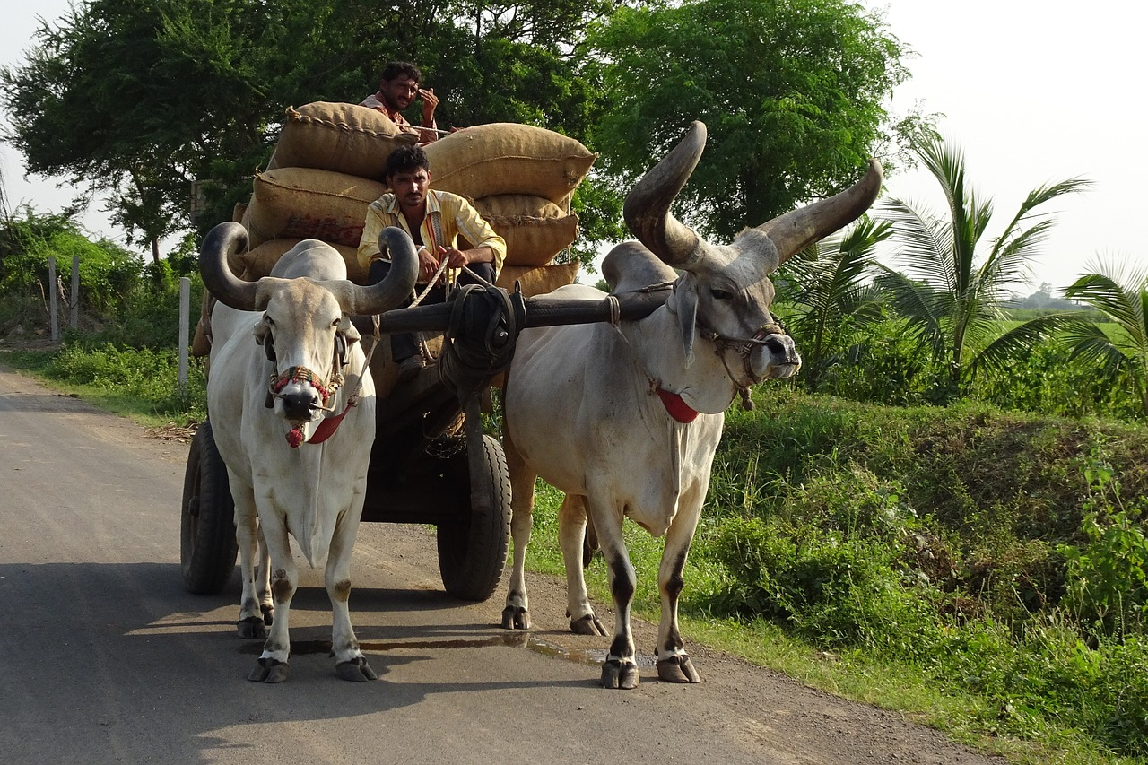
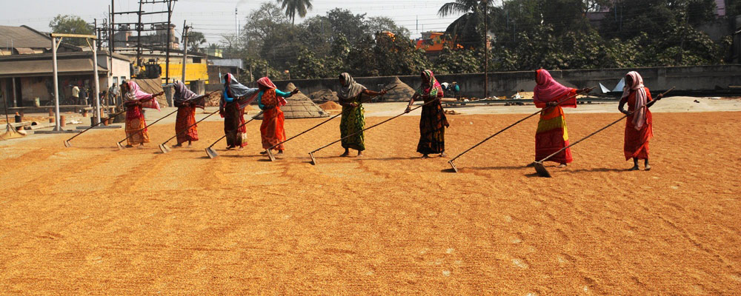

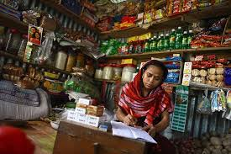
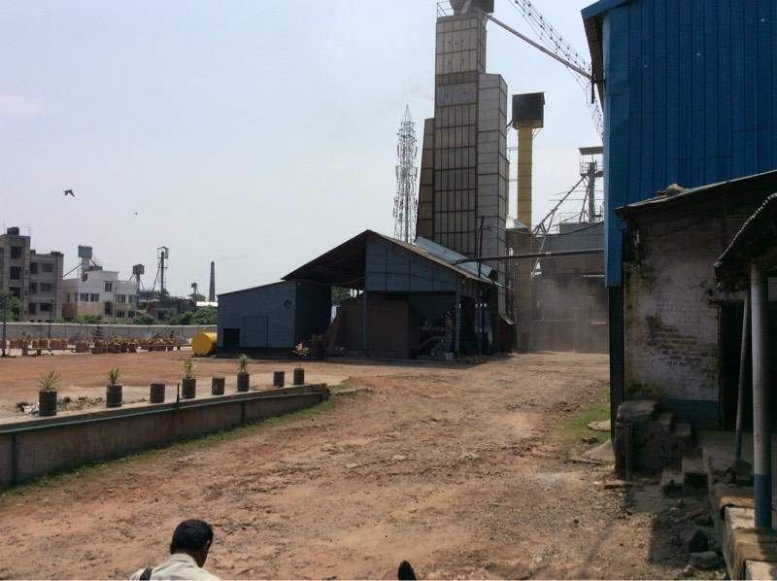

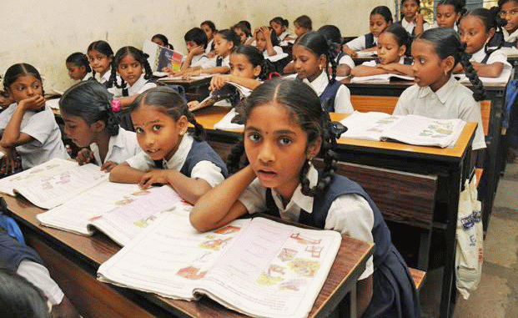

Socio-Economic Contributions of Entrepreneurs: Multiplication Effect

Slide 3
Questions to Be Answered
Techno-economic contributions of entrepreneurs?
Why should one aspire to become an entrepreneur?
Roles of entrepreneurs in the progression of our civilization?
Entrepreneurship and GDP growth?
What makes the present situation perfect for startups?
Is it the right time to start a startup?
Can we compete with global companies?

Slide 4
Definition of Some Keywords
Entrepreneur and entrepreneurship
Innovation, vision, alleviate pain, calculated risk
Value proposition
GDP
Velocity of money
Value of money
Notes:
GDP is defined in terms of expenditure, production or income.
Gross domestic product (GDP) is the total monetary or market value of all the finished goods and services produced within a country's borders in a specific time period.

Slide 5
Founders have three main traits:
an insurgent’s mission,
an owner’s mindset, and
obsession with the front line.
Entrepreneurs identify opportunities in adversities.
Opportunities without much risk will vanish in no time.
Notes:
the most important anthropocentric reason for preserving diversity is the role that microorganisms, plants, and animals play in providing free ecosystem services, without which society in its present form could not persist

Slide 6
Some of the Serious Crisis that Humanity Faces Today
The COVID-19 Pandemics
Growing inequalities
Lost diversity, and
Climate change
are some of the existential crisis that are threatening the humankind.
Notes:
the most important anthropocentric reason for preserving diversity is the role that microorganisms, plants, and animals play in providing free ecosystem services, without which society in its present form could not persist

Slide 7
Crisis and Opportunities
Winston Churchill is credited to have said:
“Never let a good crisis go to waste”.
Crisis opens up new opportunities
Notes:
Many of today’s essential technologies were received from the military.

Slide 8
Entrepreneur
Dictionary definition of entrepreneur: ‘one who organizes, manages, and assumes the risks of a business or enterprise’.
Entrepreneurs have a compelling vision or a dream to achieve something extraordinary and a comprehensive plan to execute it.
They identify opportunities in adversities or translate adversities into opportunities. Failures don’t deter them.
Identify solutions to workaround the adversities or risks and accomplish desired goals.
Comfortable with uncertainties and ambiguities, the ability to identify opportunities that others will never see and to focus on them, to be resolute, persevering, brave, open to ideas and advice.

Slide 9
Types of Business Ventures
Innovation- and Vision-Driven Entrepreneurship – characterised by easy scalability and growth of the business model.
Corporate Entrepreneurship or Intrapreneurship
Small Business
The large corporate entities and cooperatives.
Social Entrepreneurship
For profit enterprise
Not-for profit enterprise

Slide 10
Innovation and Entrepreneurship
Entrepreneurs use innovation
To develop solutions to alleviate problems persisting in a group of people.
To create differentiation in products or services gaining competitive advantage.
To alleviate risks.
Use factors of production efficiently to delineate superior value propositions and, in the process, innovate new business models.
Innovation can be perceived under many contexts and not merely in products and services development. Doing anything differently that makes better value for customers may be termed as innovation.

Slide 11
Innovation and Entrepreneurship
Schumpeter Propounded
Creative Destruction as a way of innovation and entrepreneurship. It leads to superior economic growth.

Slide 12
Innovation and Entrepreneurship
Innovation disrupts existing business model by introducing better products with superior value proposition at increasingly higher speed.
Fortune 500 firms in 1955 vs. 2014.
In about 60 years, almost 88% of the Fortune 500 companies no longer feature in the list because they have either become bankrupt or are no longer significant.
And we’re all better off because of that dynamic ‘creative destruction’.

Slide 13

Innovate or Perish
Every new employee gets a copy of the "Facebook's little red book“ that famously says:
“If we don’t create the thing that kills Facebook, someone else will”
It’s a way to communicate the history, mission, and values of the company.
One of the last pages says:
“Embracing change’ isn’t enough. It has to be so hardwired into who we are that even talking about it seems redundant. The internet is not a friendly place. Things that don’t stay relevant don’t even get the luxury of leaving ruins. They disappear.”

Slide 14
The Vision
Vision is where the company wants to be or what it aspires to accomplish in the long run.
It relates to the dream and passion.
Bill Gates envisioned to see personal computers in every home [and not really the progression of business].
One of Elon Musk's visions is to see humankind travel to Mars and live there. [But the design of the spacecraft is not part of that vision. But the vision guides the designs.]
Vision sets the direction for your business planning.
Founders have to be able to articulate and share a vision. A shared vision is one of the hallmarks of business success.

Slide 15
Motivation
01
To study entrepreneurship
To become entrepreneur
To become job-market-fit
To prepare to be corporate entrepreneur
To become an entrepreneur
02

Slide 16
Why should one aspire to become an entrepreneur?
Individualistic choices
Be own boss - autonomy & freedom
Personal wealth creation
Economic value creation
Social responsibility
Corporate entrepreneurship
Accomplishment
Opportunity exploitation
Solve an acute & agonizing pain
Deep knowledge in a domain
No other option but to start a business
Favorable ecosystem
Notes:
Your primary goal may be to create wealth for yourselves, family, extended families, and communities. A job can help you so much. You will struggle to make both ends meet. Possibilities around entrepreneurial ventures are endless. You can be independent, try your own ideas, accomplish whatever you cherish, work for the society, etc. Even job now a days demands entrepreneurial qualities

Slide 17
Why should one aspire to become an entrepreneur?
Some contribution of entrepreneurs are highly profound.
Wealth for self &family
Economic value creation for the nation
Socio-economic value creation
Contribution to the progression of our civilization
Notes:
Example: Thomas Alva Edison

Slide 18
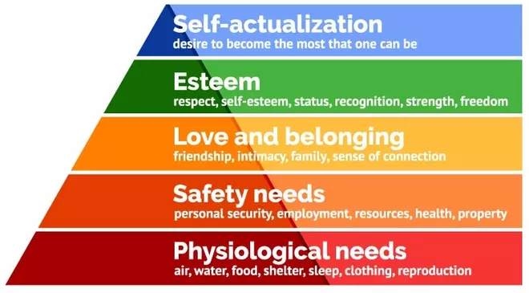
Create Something New and Feel the Sense of Achievements
Create a venture
Give jobs
Government income
Nation building
Create wealth for self, family and community
Notes:
Maslow

Slide 19
‘Global Entrepreneurship Index’ and ‘Per-Capita GDP’
Note: Annual GDP is the monetary value of all goods and services produced within the country in a year. Divide that by the number of people to get per-capita GDP.
Scatter plot
Global entrepreneurship index
Per Capita GDP
Clearly, countries with higher entrepreneurial activities generate higher per-capita GDP, which in turn leads to higher government income that leads to better infrastructure, better healthcare and better public amenities.
Data source https://thegedi.org/2019-global-entrepreneurship-index-data/
Notes:
Gross domestic products (GDP) is a monetary measure of the market value of all the final goods and services produced in a specific time period, often annually

Slide 20
‘Global Entrepreneurship Index’ and ‘Quality of Life Index’
Source https://thegedi.org/2019-global-entrepreneurship-index-data/
Scatter plot
Global entrepreneurship index
Based on data published in 2019
Quality of Life Index

Slide 21
Economic Contributions of Entrepreneurs
Entrepreneurs
Increase government income resulting in higher expenditure and more consumption.
Generate employment.
Promote savings.
Increase consumption.
Stimulate new demand by offering products of higher esteem.
It is important to know what all an entrepreneur executes and facilitates.

Slide 22
Economic Contributions of Entrepreneurs … contd.
Improve technological landscape through innovations in all key areas.
Facilitate diffusion of technologies from abroad into domestic industries resulting in technological self-reliance.
Bring foreign exchange that increases value for local currency. Increased forex reserves provide enormous power to a nation while increasing purchasing power to its citizens.
Improve quality of life of citizen.
Earn foreign exchange

Slide 23
Reliance Industries Ltd.
Reliance Industries contributes about 10% of the direct tax collection of our country.
Reliance Jio’s disruptive entry will expand India’s per capita GDP by about 5.65%, says a report by Harvard Business School#.
Imagine that we have many more such companies and the GDP and government’s income would soon multiply.
# Appeared in the Mint on 06 April 2018
Notes:
Institute for Competitiveness (IFC), a Gurugram-based Indian unit of the Institute for Strategy and Competitiveness at Harvard Business School.

Slide 24
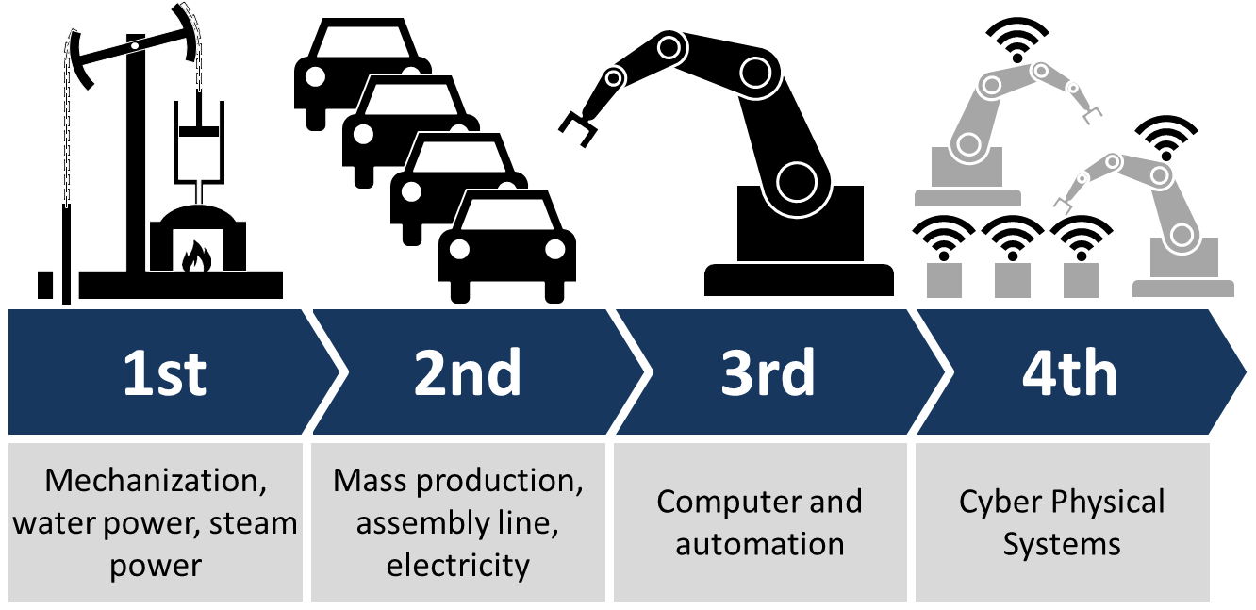
Industrial Revolutions
0th
Hand tools, animal-based manufacturing
Till 1770s | 1784 | 1870 | 1969 | Late 20th Century
Handheld roller gins had been used in the Indian subcontinent since AD 500 and then in other regions. | First Cotton Gin was put into operation. Steam engine: in 1776. | Gas & Oil, synthetic fabric, dyes & fertilizer, telegraph, telephone | Nuclear energy, electronics (PLC) & Biotechnology, | Integrations of computation, networking, and physical processes
Wikipedia.com
Image adopted from http://canadamakes.ca/industry-4-0-next-industrial-revolution/
Notes:
1870 – first electric generator
1881 – public power station
PLC – Programmable Logic Control

Slide 25
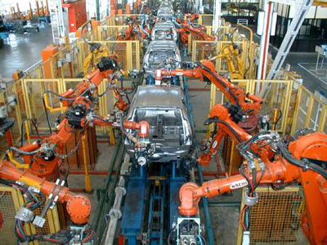
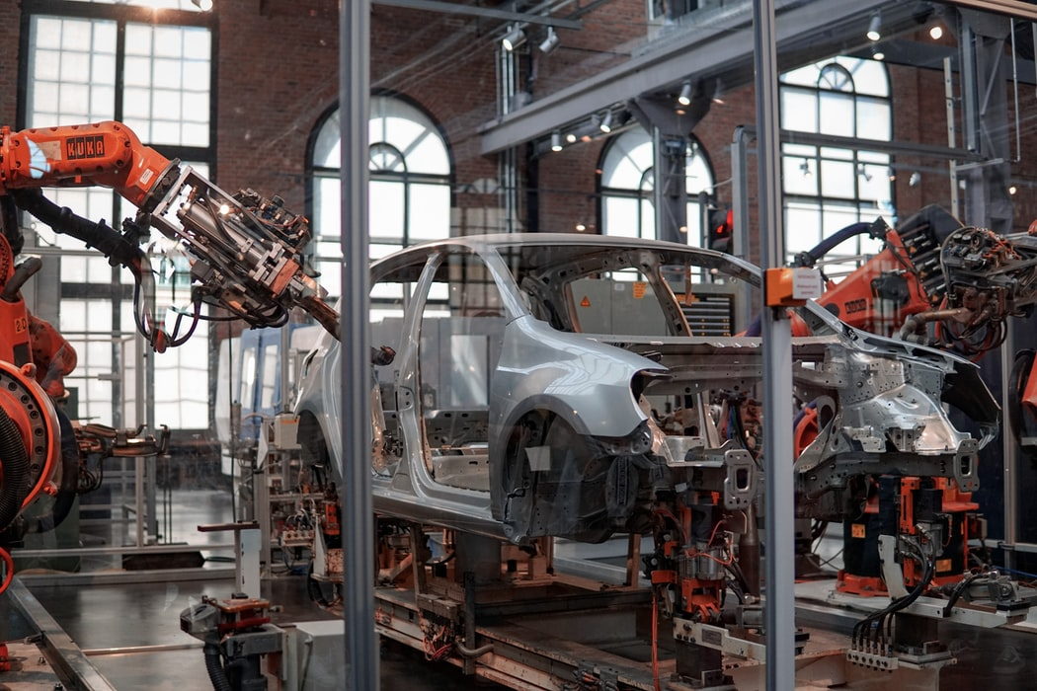
Computer and automation

Slide 26
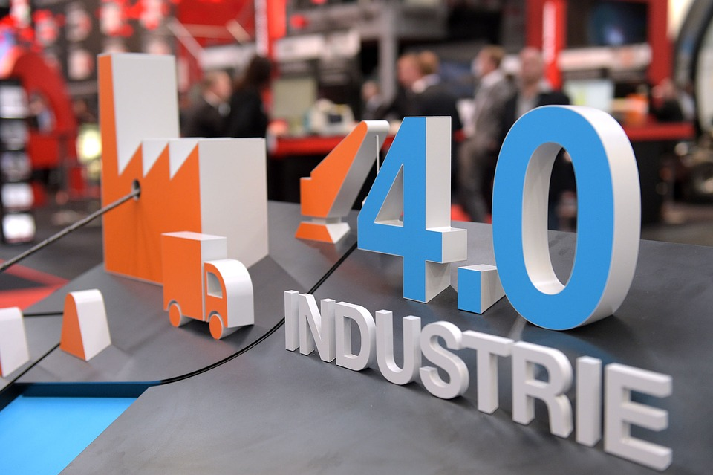
Industry 4.0
Industry 4.0: started during 1990s.
IoT, additive manufacturing, Cloud computing, AI, e-vehicles, Autonomous vehicle, Business intelligence, Smart machines, etc.

Slide 27

4.0
Business intelligence
Smart factory
Cloud computing
Big data
AI-ML
Digitization
Blockchain
Electronic healthcare
Autonomous transportation
Cryptocurrency

Slide 28
But where are we in this technological revolution landscape?

Slide 29
Historical GDP of India vis-à-vis the World
Year | GDP (1990 dollars) | % of world GDP | Population | % of world population | Period
1 | 33.750 | 32.00 | 70.000 | 30.3 | Classical era
1000 | 33.750 | 28.00 | 72.500 | 27.15 | Early medieval era
1500 | 60.500 | 24.35 | 79.000 | 18.00 | Late medieval era
1600 | 74.250 | 22.39 | 100.000 | 17.98 | Early modern era
1700 | 90.750 | 24.43 | 165.000 | 27.36
1820 | 111.417 | 16.04 | 209.000 | 20.06
1870 | 134.882 | 12.14 | 253.000 | 19.83 | Colonial era (British era)
1913 | 204.242 | 7.47 | 303.700 | 16.64
1950 | 222.222 | 4.17 | 359.000 | 14.11 | Republic of India

Slide 30
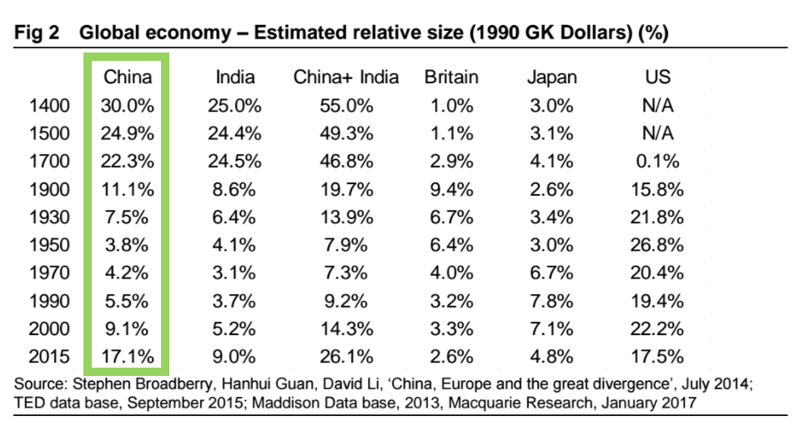
Historical GDP of India vis-à-vis the World

Slide 31
What went wrong?
We were under seize
We lost our entrepreneurial zeal
It made us risk averse
Now our parents motivate us to think that a government job is the most coveted career objective.
In the process, we have become victims of many myths
Data on failure rate of startups intimidate us
The imperial world focused on R&D and entrepreneurial venture creation.

Slide 32
Myths that we are victim of and the reality
Myth: Entrepreneurs are born, not made
Fact: Dhirubhai Ambani, Narayana Murthy, Sunil Bharti Mittal, Sabir Bhatia, Steve Jobs, John D. Rockefeller, Andrew Carnegie
Myth: It takes a lot of money to start a business
Facts: More than 80 percent of new ventures are bootstrapped.
Myth: Entrepreneurs are born in business families
Entrepreneurship is mostly associated with ‘First Generation Entrepreneurs’.
Myth: Entrepreneurs are extroverts
Fact: Blake Masters and Peter Thiel have shown that 10 out of 11 successful entrepreneurs are introvert.

Slide 33
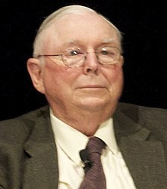
Is failure so obvious?
42% of the well funded ventures fail as they want to sell something that nobody wants to buy.
Remedy: Validated learning
29% of the well funded ventures fail as they run out of cash
Remedy: Understand finance and do the projected cash flow.
23% fail due to disharmony among founders
Remedy: follow the time-tested team building process
“All I Want To Know Is Where I’m Going To Die So I’ll Never Go There.” – Charlie Munger
Notes:
Charlie Munger – the great friend of Warren Bufet

Slide 34
The greatest success factor
Timing
Bill Gross provided evidence that timing is the single biggest reason that startups succeed.
Victor Hugo said: There is one thing that all the military in the world can not defeat that is an idea whose time has come.
Why the present time is so great

Slide 35
Why the present time is so great
India now has the consumption power
If we do not create capability, our dependence on foreign goods will only increase making them richer.
We have demographic advantage.
We are rich in natural resources.
No dearth of knowledge workers.
Government policies are very favorable.
Matured ecosystem in place.

Slide 36
Can we compete or is it just pipe dream?
Hero Motor, Bajaj, TVS has driven competition out whichever markets they entered.
We are already the global producer of pharmaceuticals.
Several Indian companies have reported early success towards possible treatment of COVID.
Two COVID Vaccines have received approval.
We are playing leading role in the technology sphere.

Slide 37
Do you have the elements to successfully create and grow a venture?
Almost all the qualities of successful entrepreneurs such as leadership qualities, people skill, empathy, finance, marketing, strong peer network, tolerance to ambiguity can be inculcated to a large extent.
Unless you start, you will never know what you are really capable of.

Slide 38
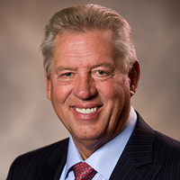
“If you're not failing, you're probably not really moving forward.”
“Fail early, fail often, but always fail forward.”
― John C. Maxwell, Failing Forward: How to Make the Most of Your Mistakes
Notes:
The objective of this session is to understand the causes of failure so that we have some idea as to how not to fail.

Slide 39
Intrapreneurship/ Corporate Entrepreneurship
Process or strategies of intrapreneurship or corporate entrepreneurship within a company:
Employees within the organization who are creative, proactive, have the gumption to embrace calculated risk to achieve higher goals can pursue disruptive innovation within the larger mission of the organization using the resources, capabilities and security of the company to draw upon.

Slide 40
Anand Shanwal - cbinsight
What do Uber, Facebook, and Starbucks have in common?
They all have strong business moats — key competitive advantages that set a company apart and make it hard for competitors to enter.
It’s what drove Amazon to post $96B in revenue in Q3’20. It’s how Google has maintained its hold on over 85% of the search engine market.
Today, the most durable business moats are being built on advantages like network effects, data, and repeat engagement within a product ecosystem.

Slide 41
Some Books You Can Reffer
The hard thing about hard thing - by Ben Horowitz
Zero to One - by Peter Thiel and Blake Masters
Good to Great - by James C Collins
Four Steps to Epipheny - by Steve Blank
The E-Myth Revisited - by Michael E Gerber

Slide 42
http://benbarry.com/project/facebooks-little-red-book
Stel A. v, M. Carree and R. Thurik (2005), The effect of entrepreneurial activity on national economic growth, Small Business Economics, Vol. 24, No. 3, pp. 311-321
Praag C. M. Van, and P. H. Versloot (2007), What is the value of entrepreneurship? A review of recent research, Small Business Economics, Vol. 29, pp. 351–382
Aparicio S., D. Urbano and D. Audretsch (2016) Institutional factors, opportunity entrepreneurship and economic growth: Panel data evidence, Technological Forecasting and Social Change, Technological Forecasting and Social Change, Vol. 102, pp. 45–61
Rajiv Shah, Zhijie Gao, Harini Mittal (2015) Innovation, Entrepreneurship, and the Economy in the US, China, and India – Elsevier
Sean Ammirati (2016) The Science of Growth: How Facebook Beat Friendster—and How Nine Other Startups Left the Rest in the Dust, St. Martin’s Press.

Slide 43
Thank You

